Slide 1
LENDING CLUB CASE STUDY
CONTRIBUTORS:
DEVAPRIYA A S
RAHUL ADEPPU

Slide 2
PROBLEM STATEMENT
You work for a consumer finance company which specialises in lending various types of loans to urban customers.
Your aim is to assess the loan applicants for the risk of default.
The objective of the case study is to use EDA to to understand how consumer attributes and loan attributes influence the tendency of default
The ultimate goal is to understand the driving factors behind loan default, which the company can utilise for its portfolio and risk assessment.

Slide 3
ANALYSIS APPROACH
Cleaning the data
Looking for columns with no data
Removing all columns with null values.
Removing data that are not useful: There are features or columns in the data which doesn't contribute to the loan defaulting in any way due to irrelevant information. So, removing them.
Checking and handling missing values
Standardizing the data
Outlier Treatment
Visualizing Categorical Data

Slide 4
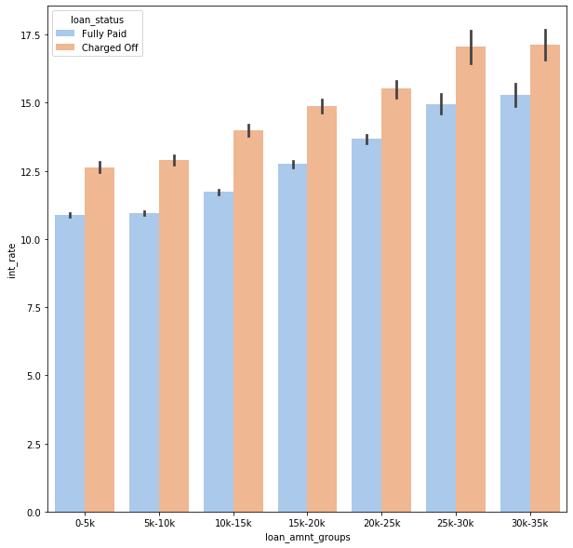
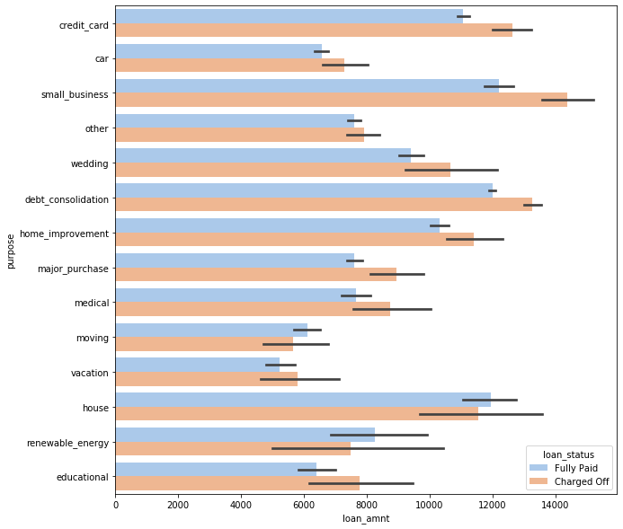
OBSERVATIONS

Slide 5
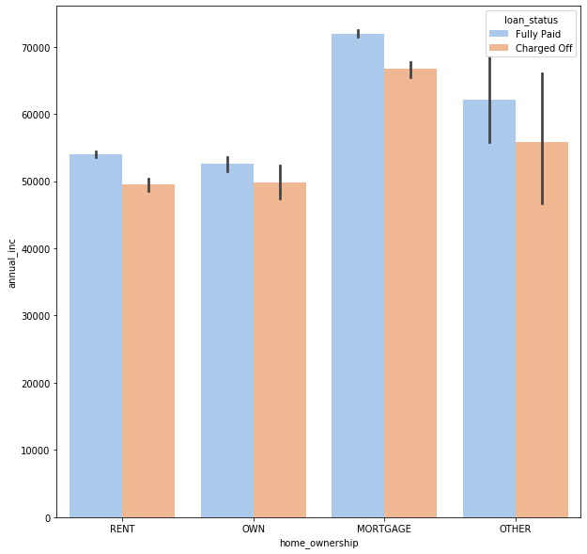
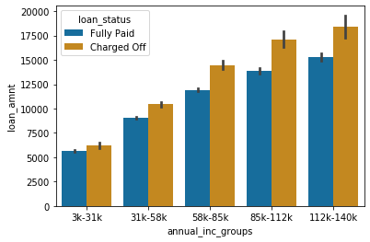
OBSERVATIONS

Slide 6
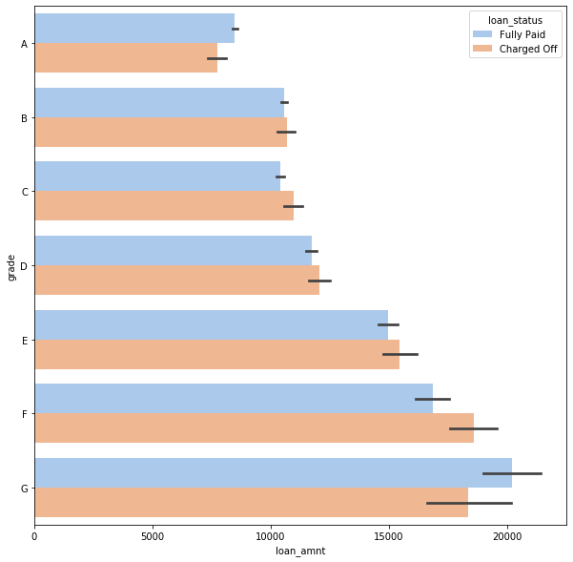
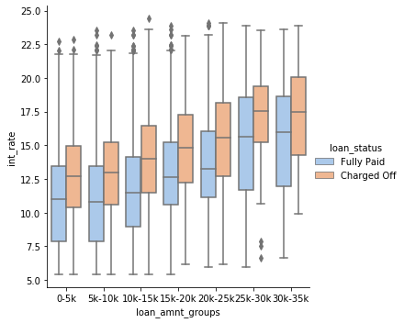
OBSERVATIONS

Slide 7
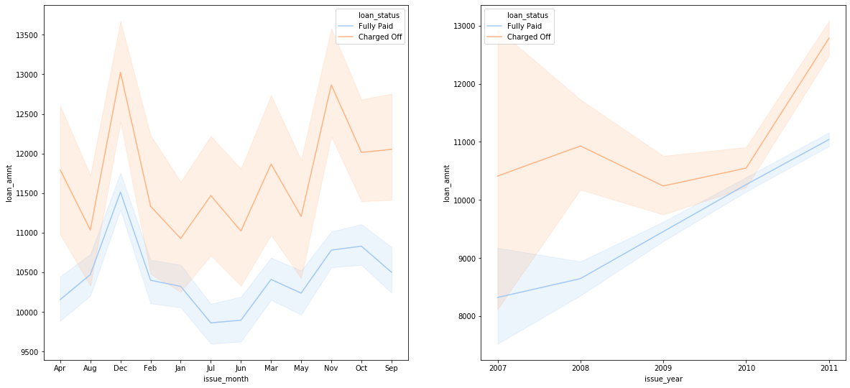
OBSERVATIONS

Slide 8
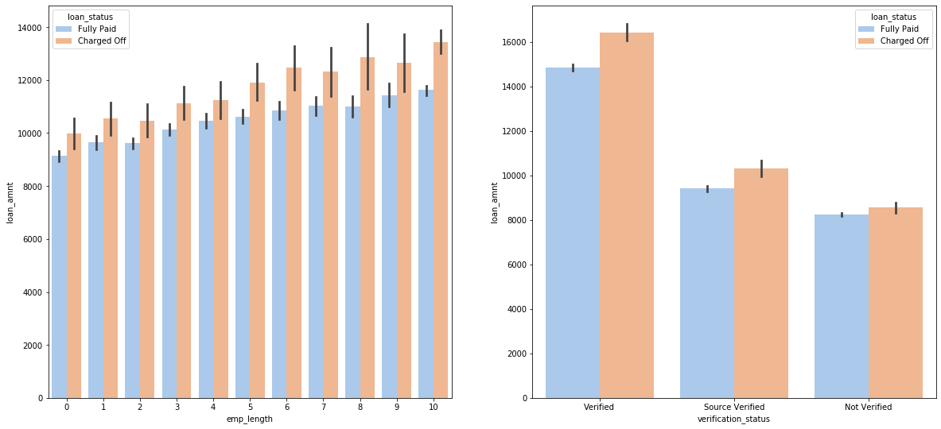
OBSERVATIONS

Slide 9
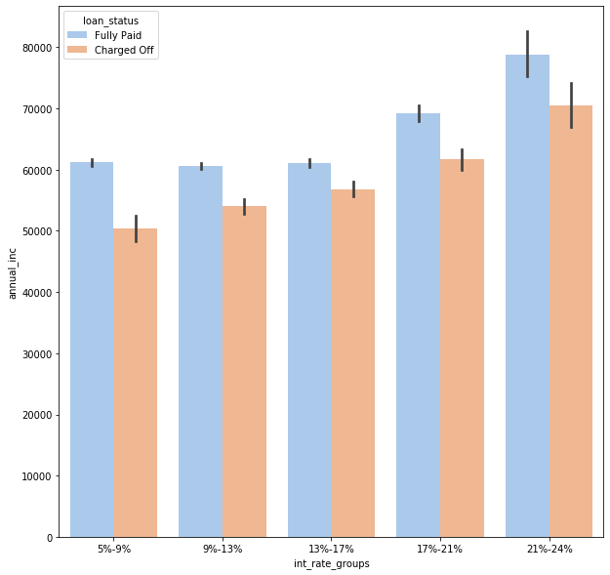
OBSERVATIONS

Slide 10
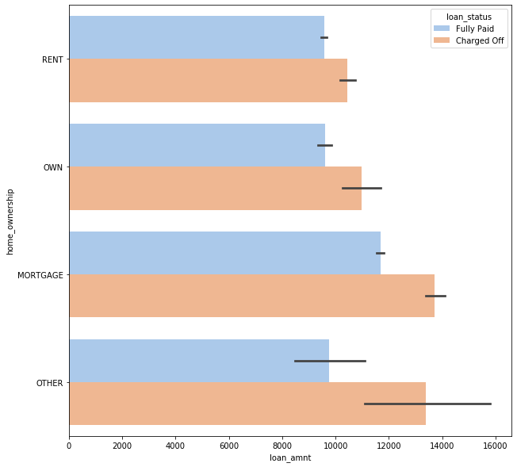
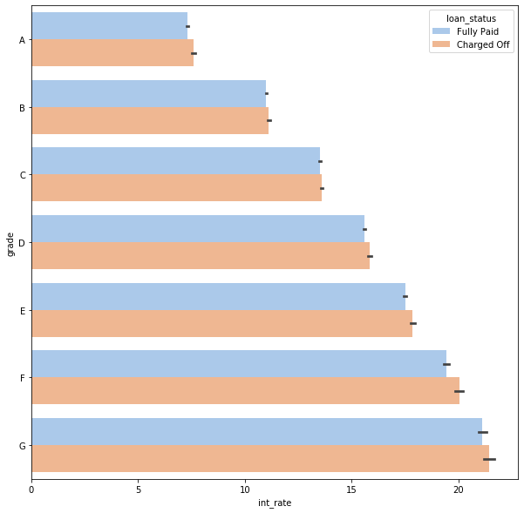
OBSERVATIONS

Slide 11
CONCLUSIONS
The analysis shows that there is a more probability of defaulting when
Applicants taking loan for 'home improvement' and have income of 60k -70k
Applicants whose home ownership is 'MORTGAGE and have income of 60-70k
Applicants who receive interest at the rate of 21-24% and have an income of 70k-80k
Applicants who have taken a loan in the range 30k - 35k and are charged interest rate of 15-17.5 %
Applicants who have taken a loan for small business and the loan amount is greater than 14k
Applicants whose home ownership is 'MORTGAGE and have loan of 14-16k
When grade is F and loan amount is between 15k-20k
When employment length is 10yrs and loan amount is 12k-14k
When the loan is verified and loan amount is above 16k
For grade G and interest rate above 20%

